Slide 1




Characterization of Ar/N2 gaseous mixtures for MPGD-based detectors.
EP-DT Training Seminar
Genaro Barco
Supervisors:
Diego Gonzalez Diaz
Florian Brunbauer
Pablo Amedo
Notes:
Add DRD1 logo

Slide 2
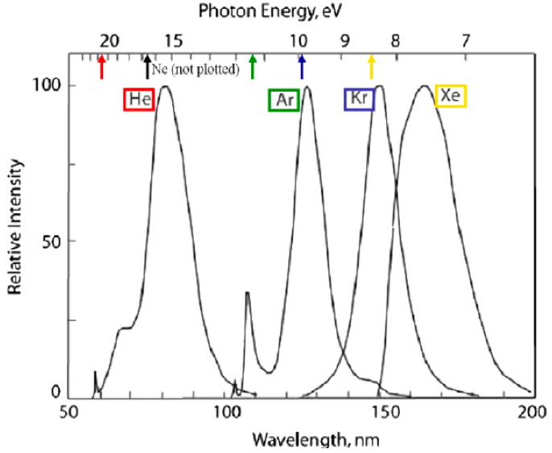
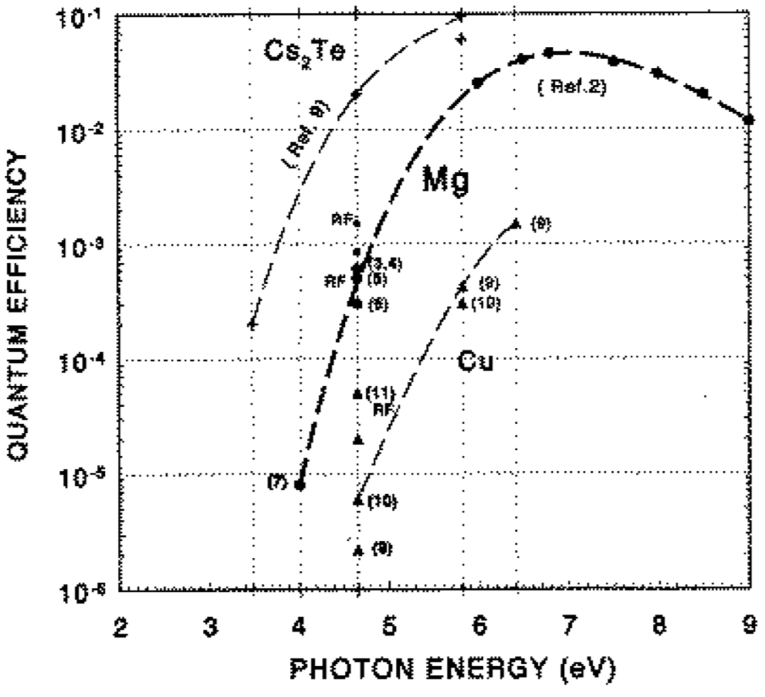
2
Technological challenge
Noble gases scintillate in the VUV (2nd continuum)
Photoelectric effect causes feedback in wire chambers!
Quenchers are added to Ar (e.g., CH₄), to eliminate scintillation and increase MWPC gain.
05 - 08 - 2025

Slide 3
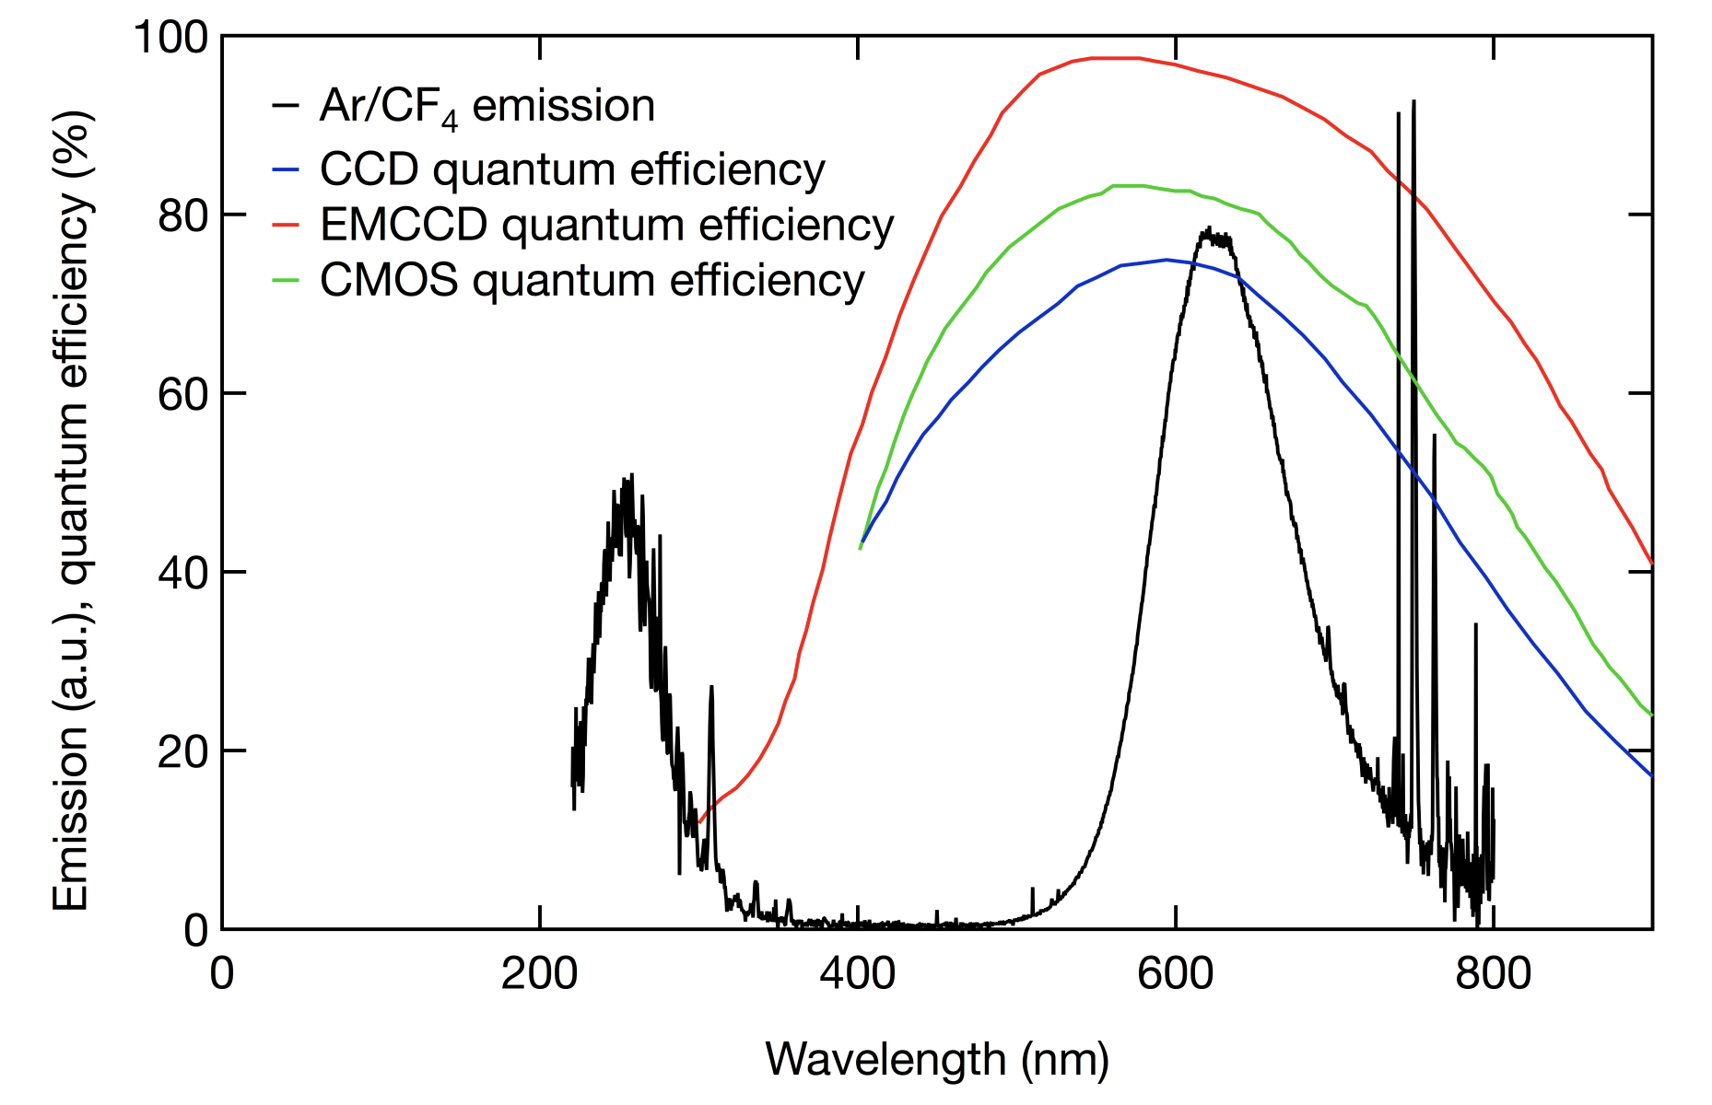
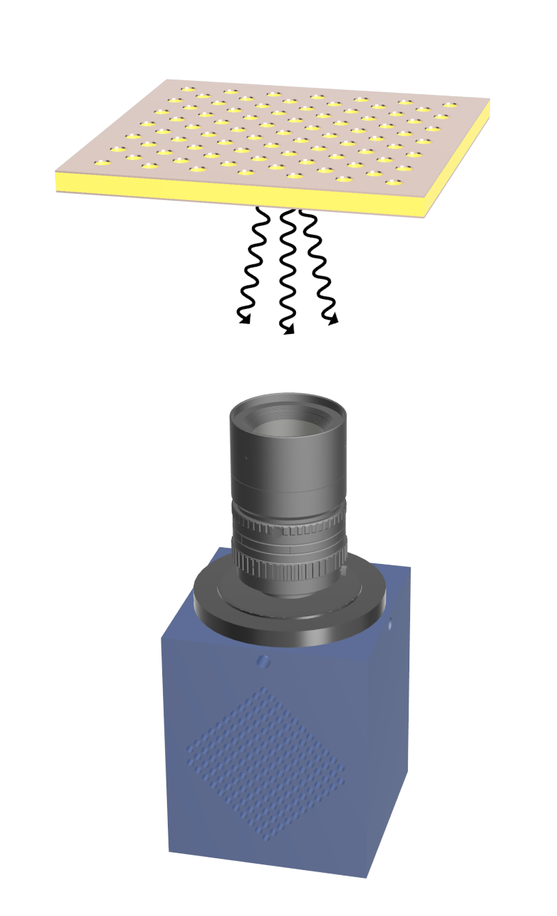
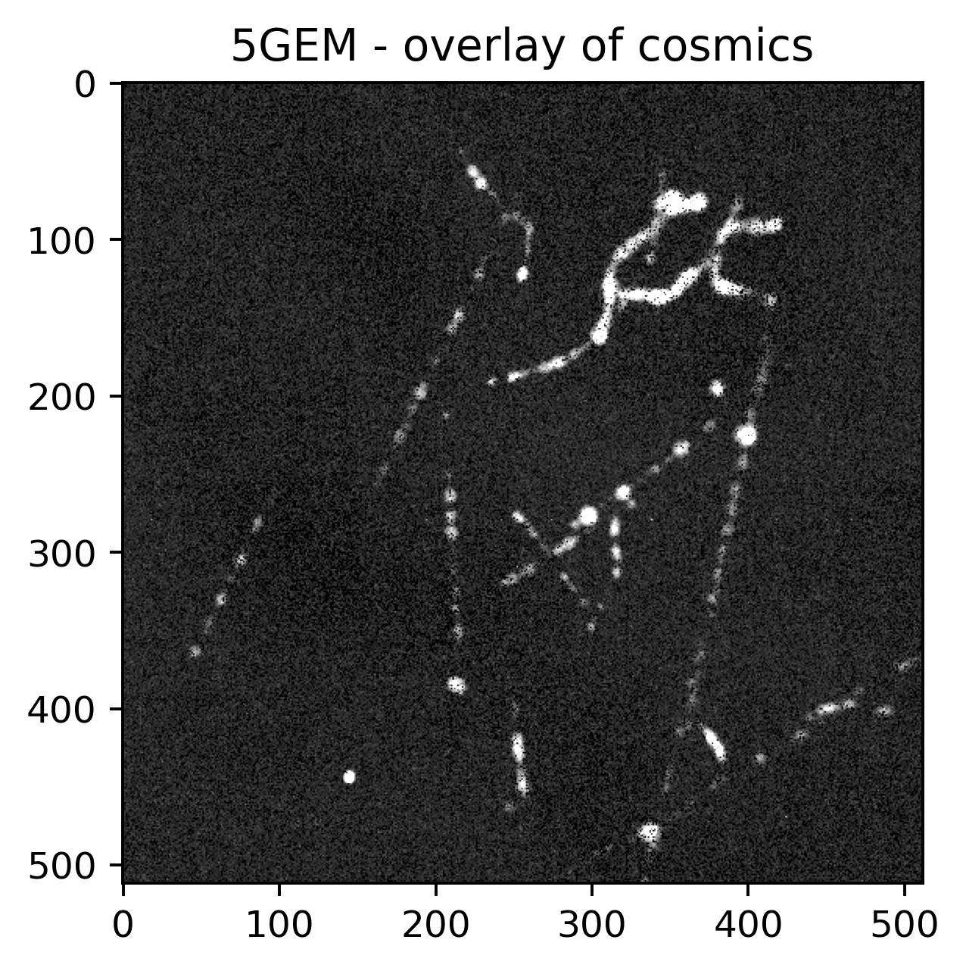
3
Optical Readout
Gas scintillation spectra need to be matched with sensor QE
Barco, G.
05 - 08 - 2025
Notes:
We want an alternative to CF4

Slide 4
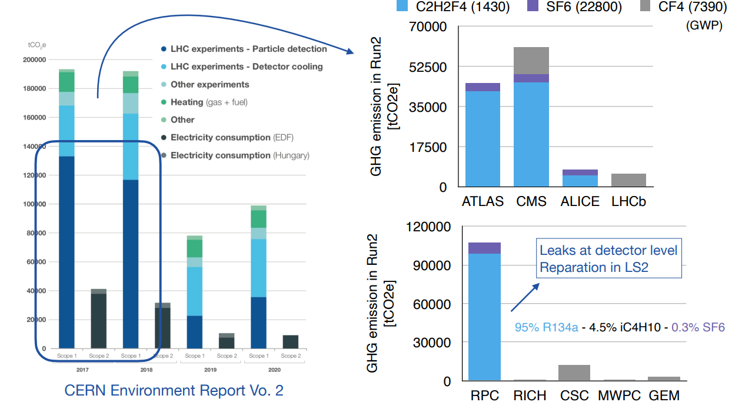
Current situation
4
Barco, G.
05 - 08 - 2025

Slide 5
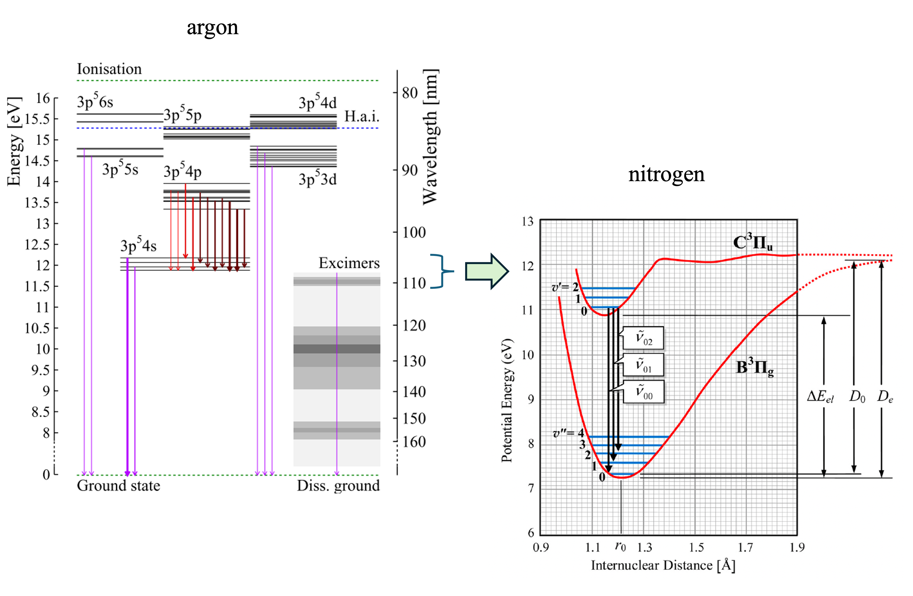
5
Nitrogen deactivates the Ar emission and scintillates on its own
05 - 08 - 2025

Slide 6
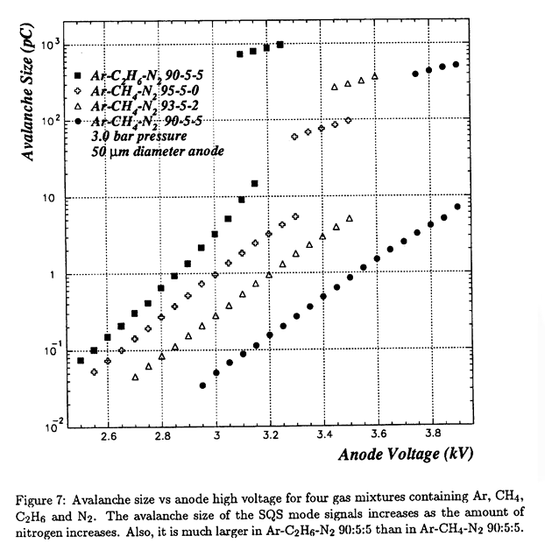
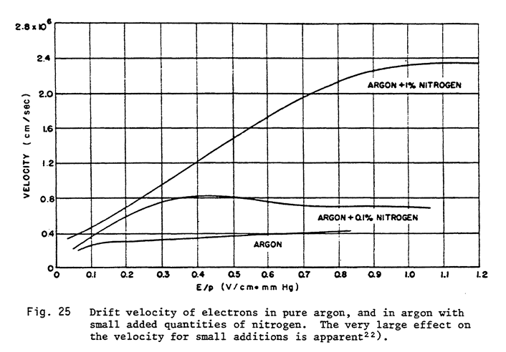
6
Previous knowledge
Avalanche size
Drift Velocity
T. Zhao, A study of gas mixtures for ATLAS MDT, Atlas internal note, 1995
F. Sauli – CERN Yellow paper - 1977
Barco, G.
Notes:
A possible solution, what will I add to this knowledge?

Slide 7
Set-up

Slide 8
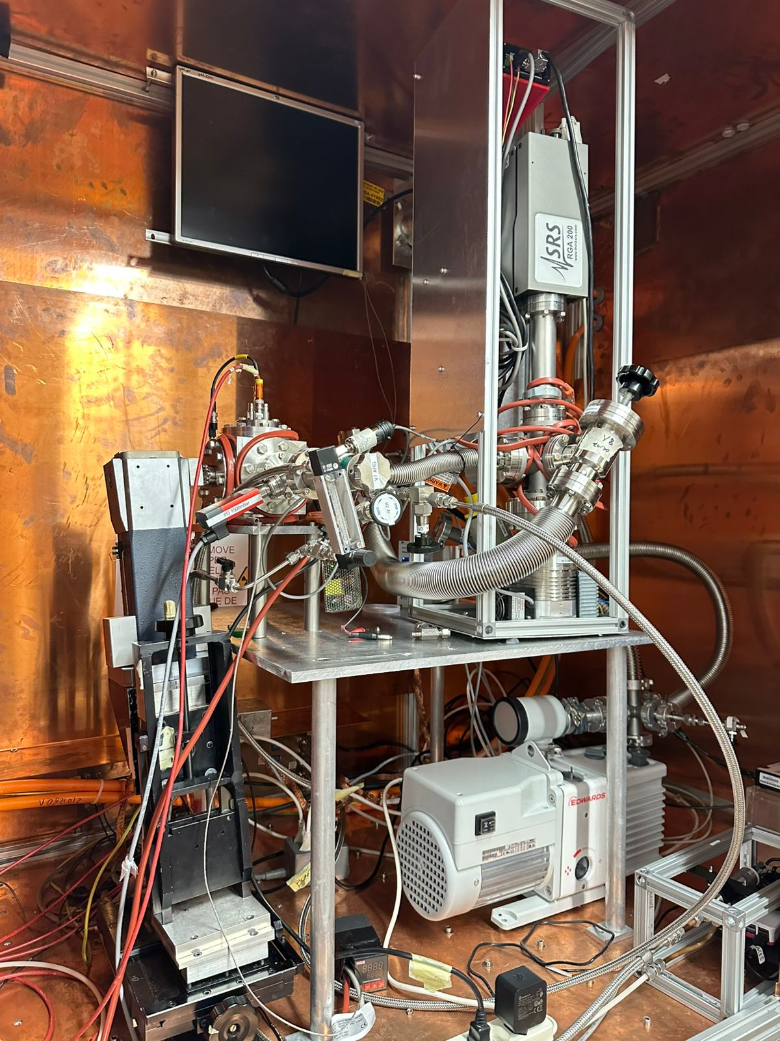
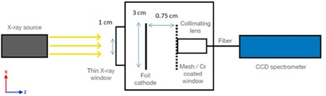
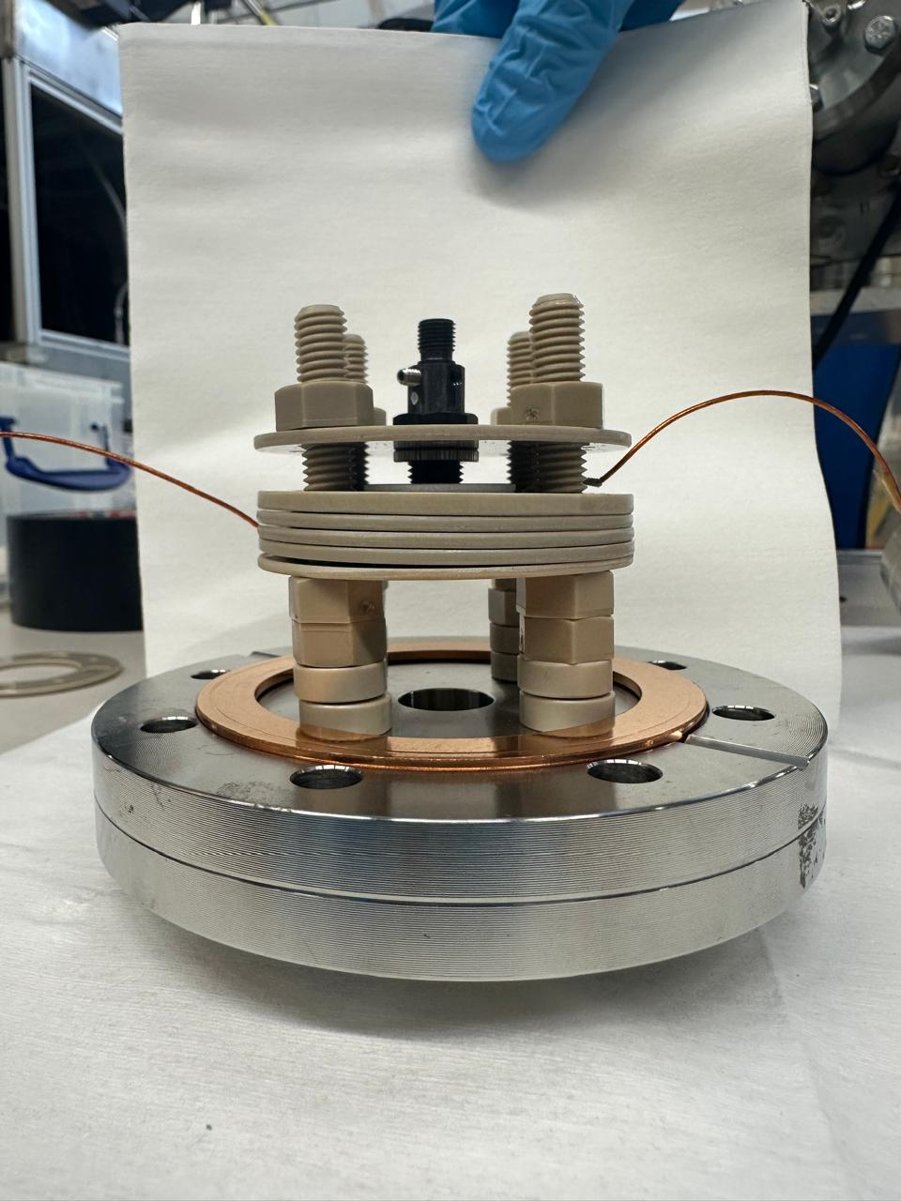
8
X-rays
Fiber
05 - 08 - 2025

Slide 9
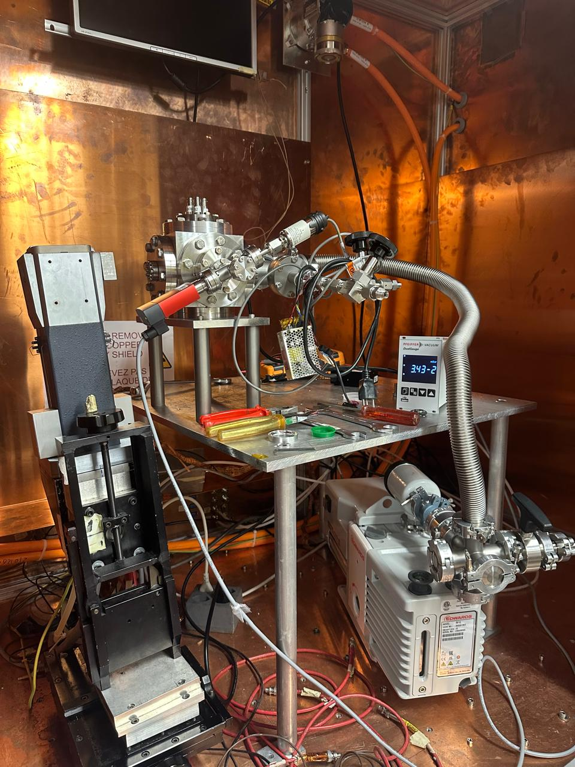
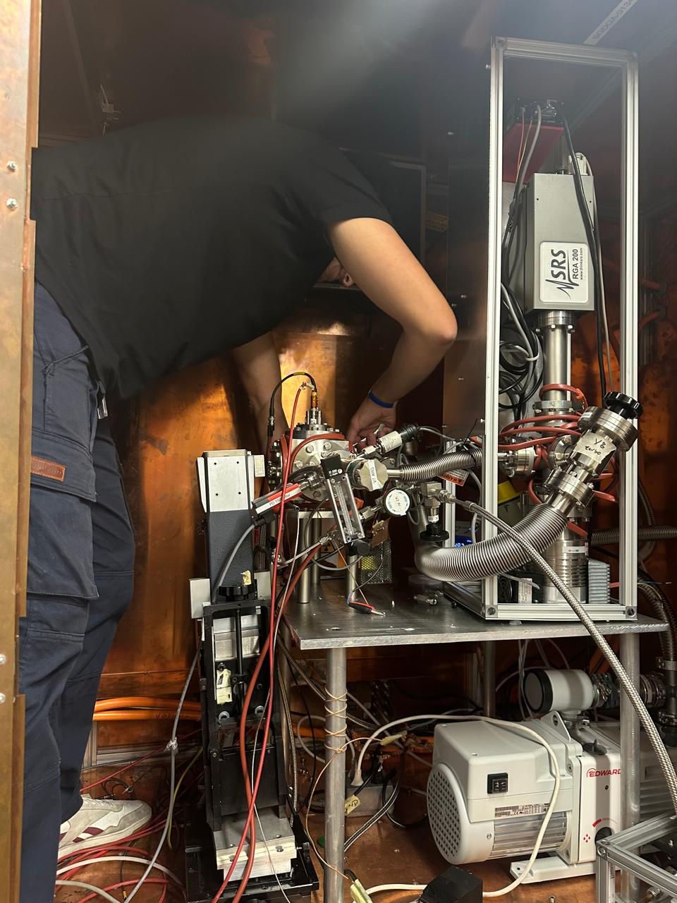
9
Barco, G.
05 - 08 - 2025

Slide 10
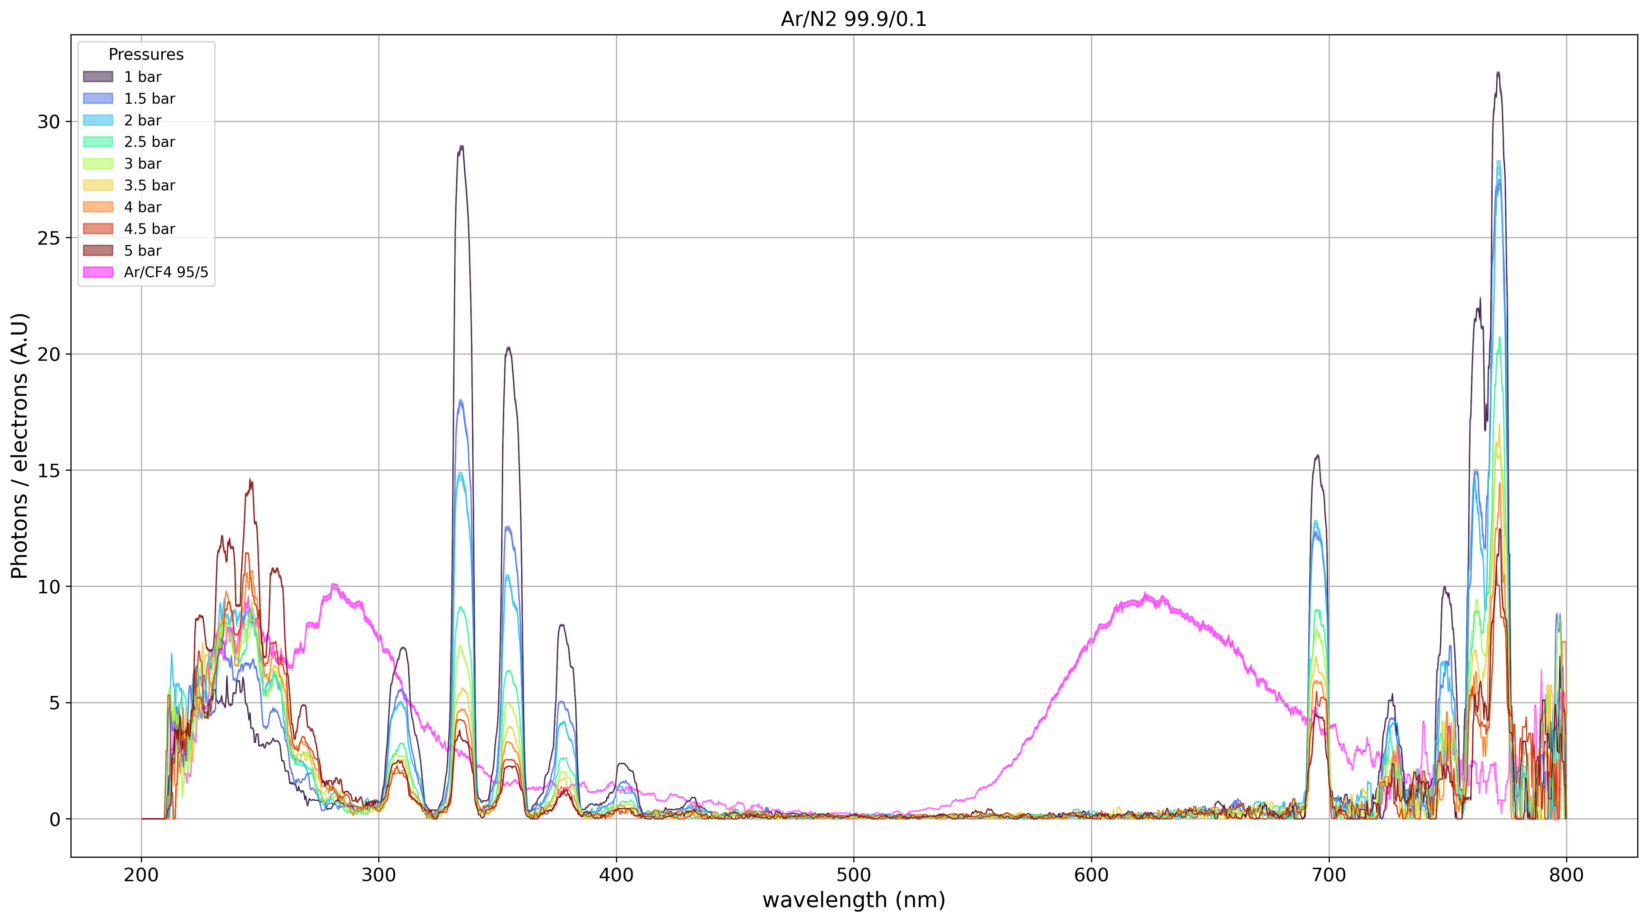
10
Barco, G.
05 - 08 - 2025

Slide 11
11
Nitrogen
Argon
Nitric Oxide
Barco, G.
05 - 08 - 2025

Slide 12
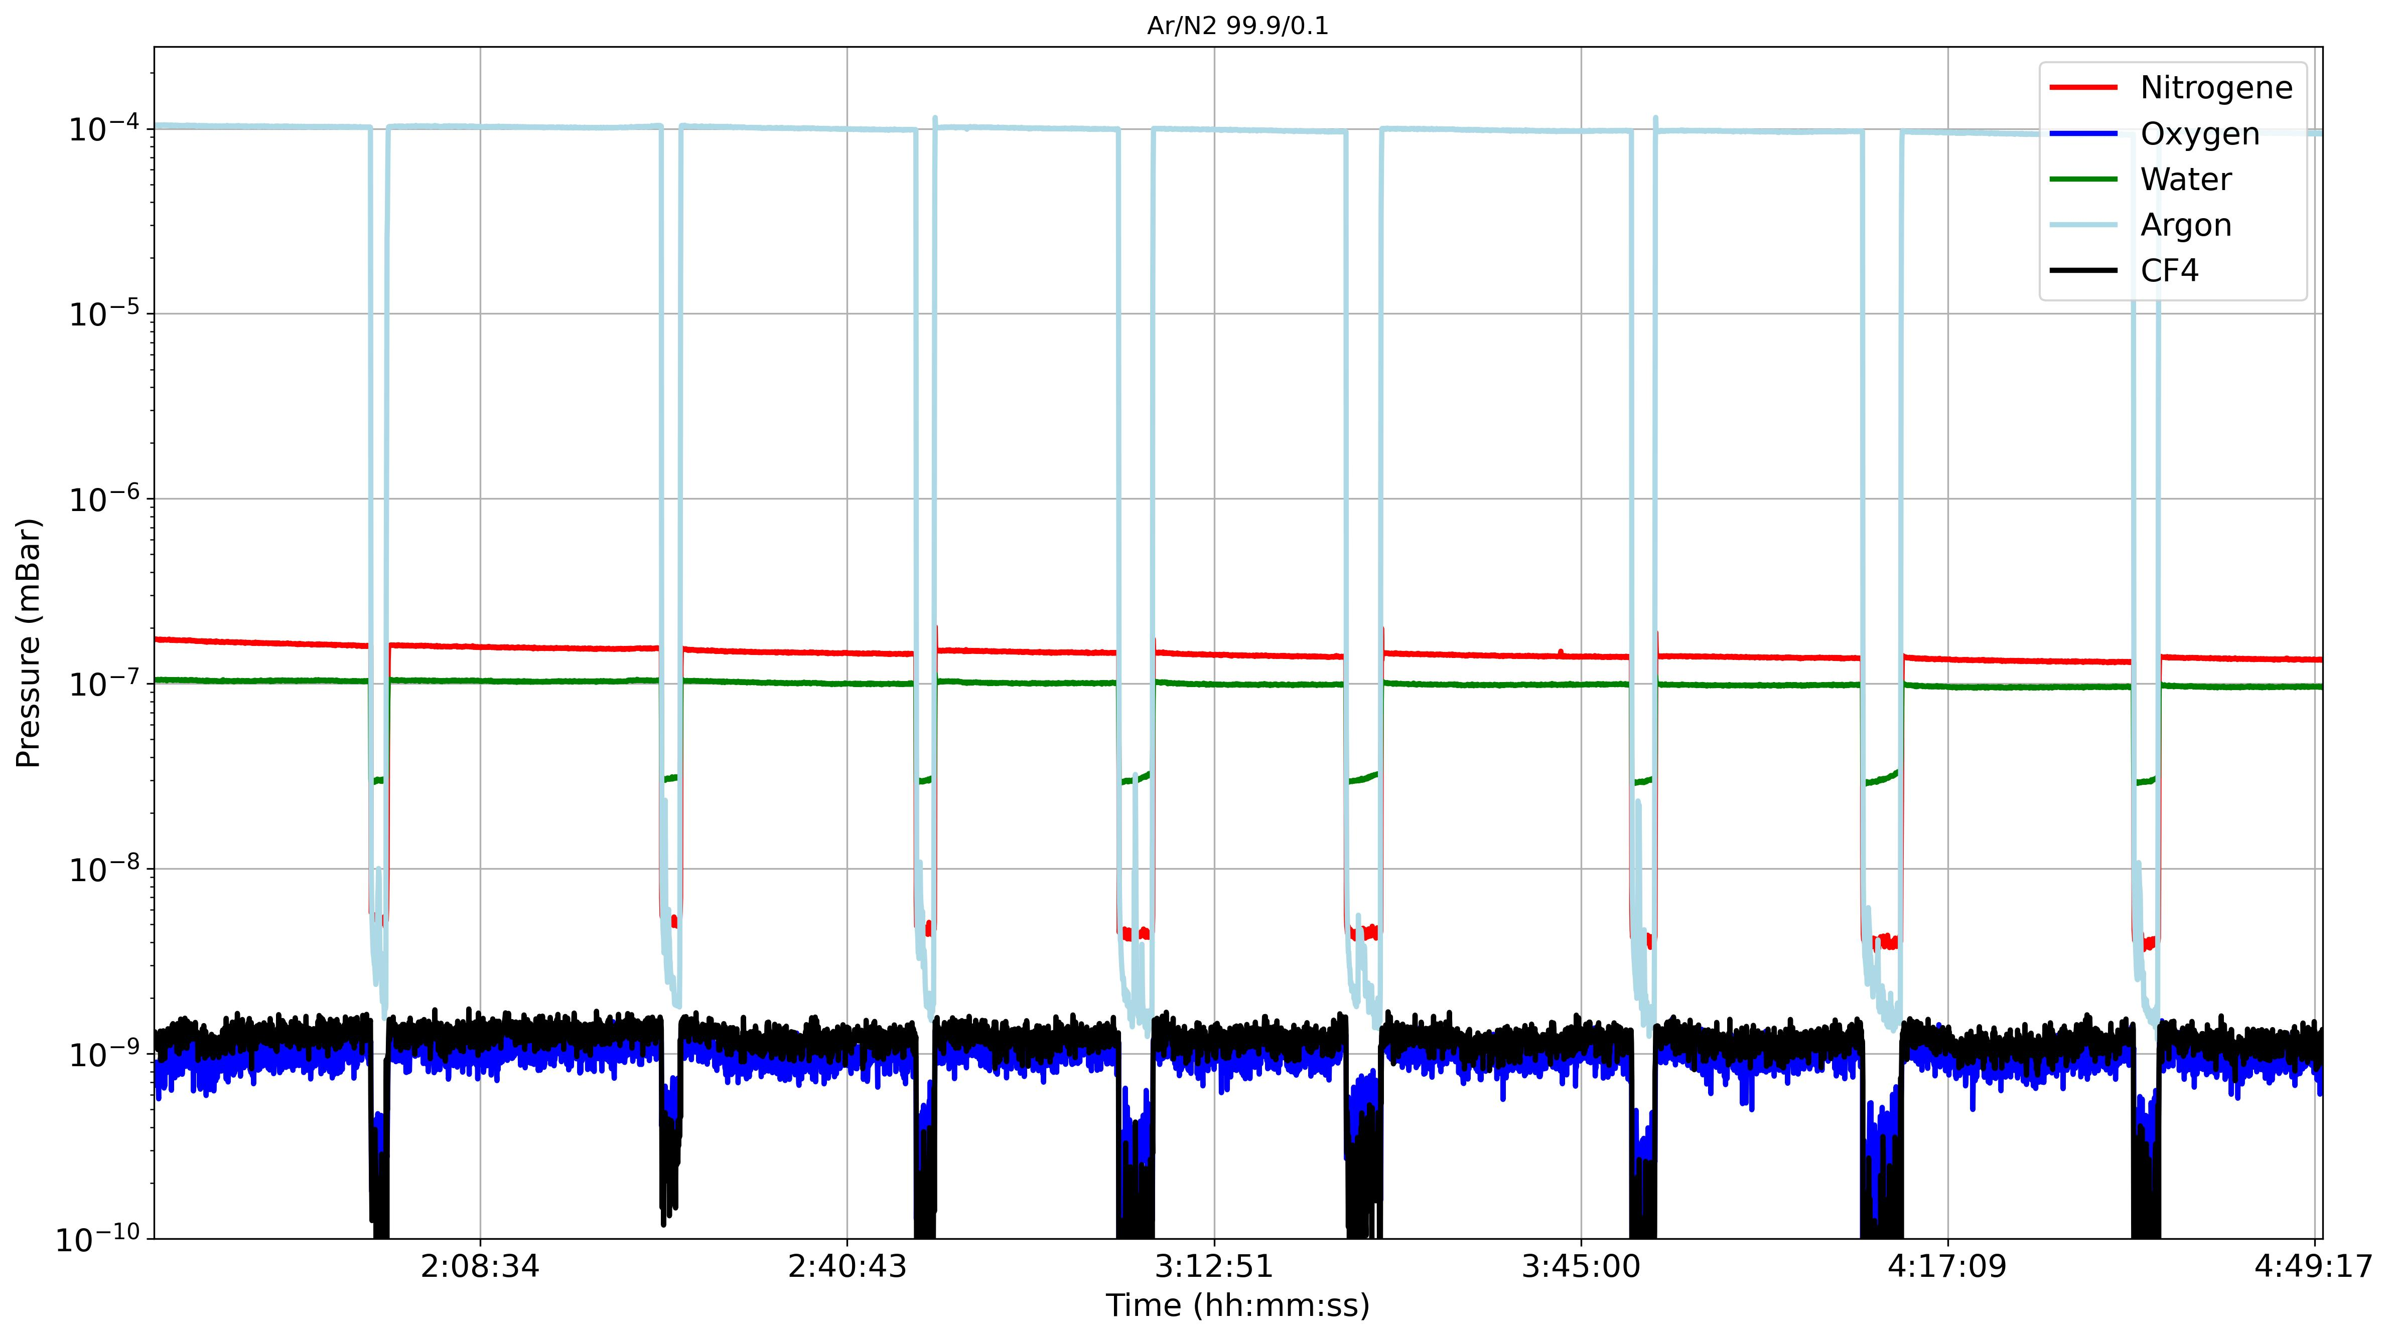
12

Slide 13
Results
Field dependence of scintillation spectra in Ar/N2 mixture:
Notes:
We might expect recombination if the are space charge, but we don’t expect it in primary scintillation

Slide 14
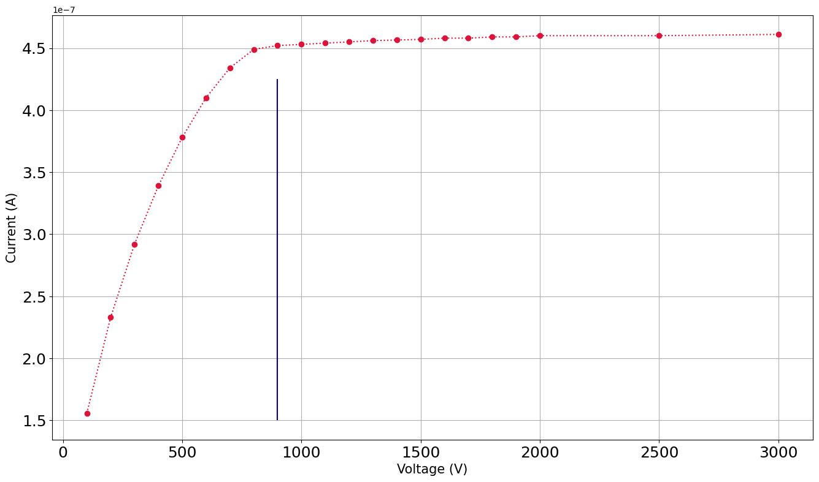
14
Saturation Current
Max. Collection Field
Barco, G.
05 - 08 - 2025

Slide 15
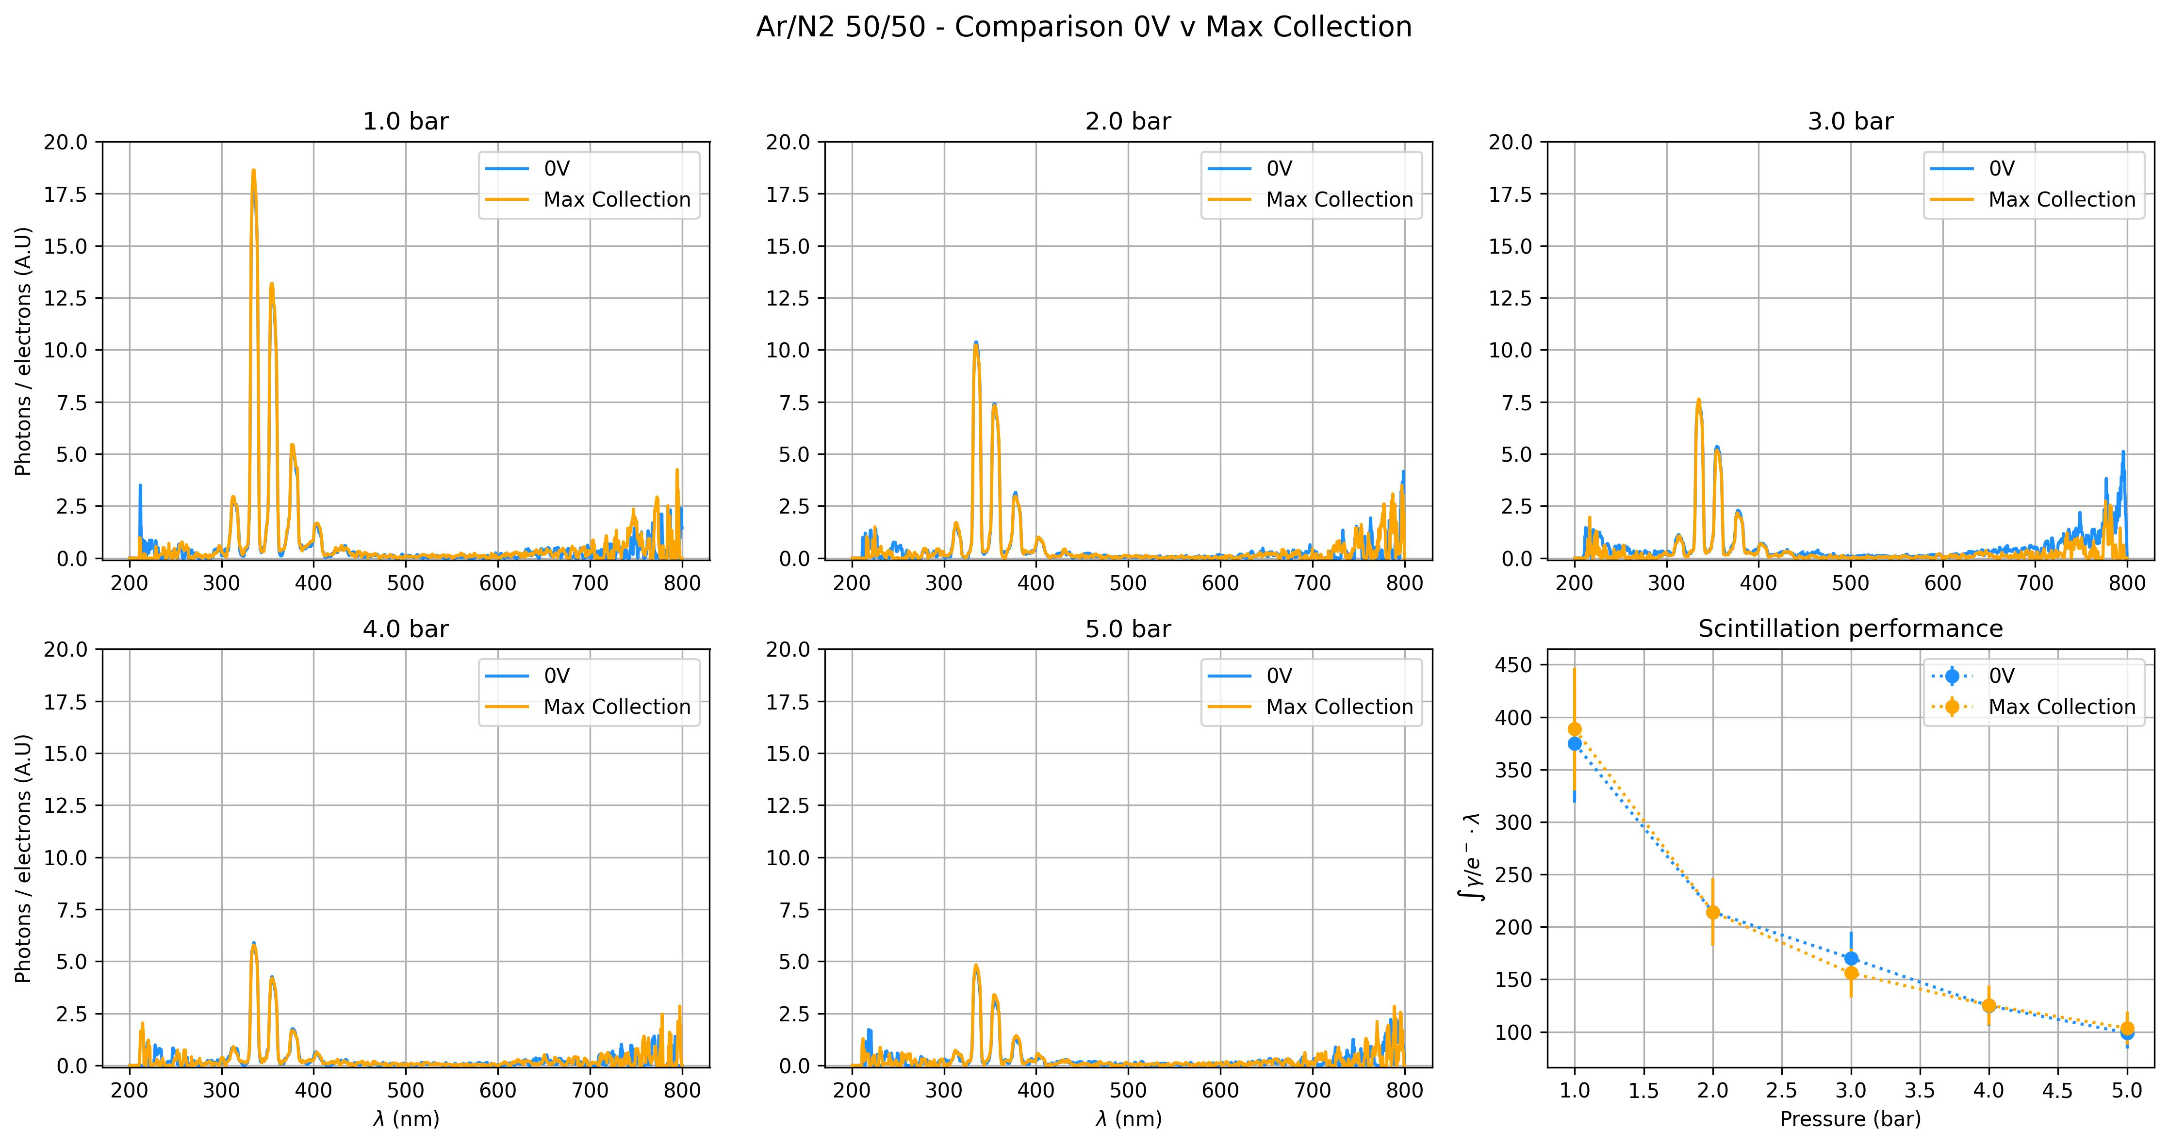
15

Slide 16
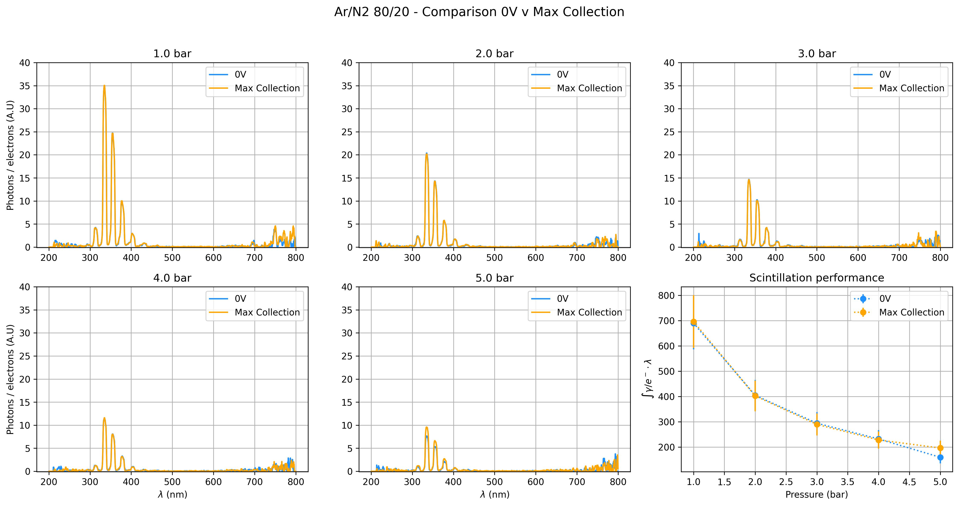
16

Slide 17
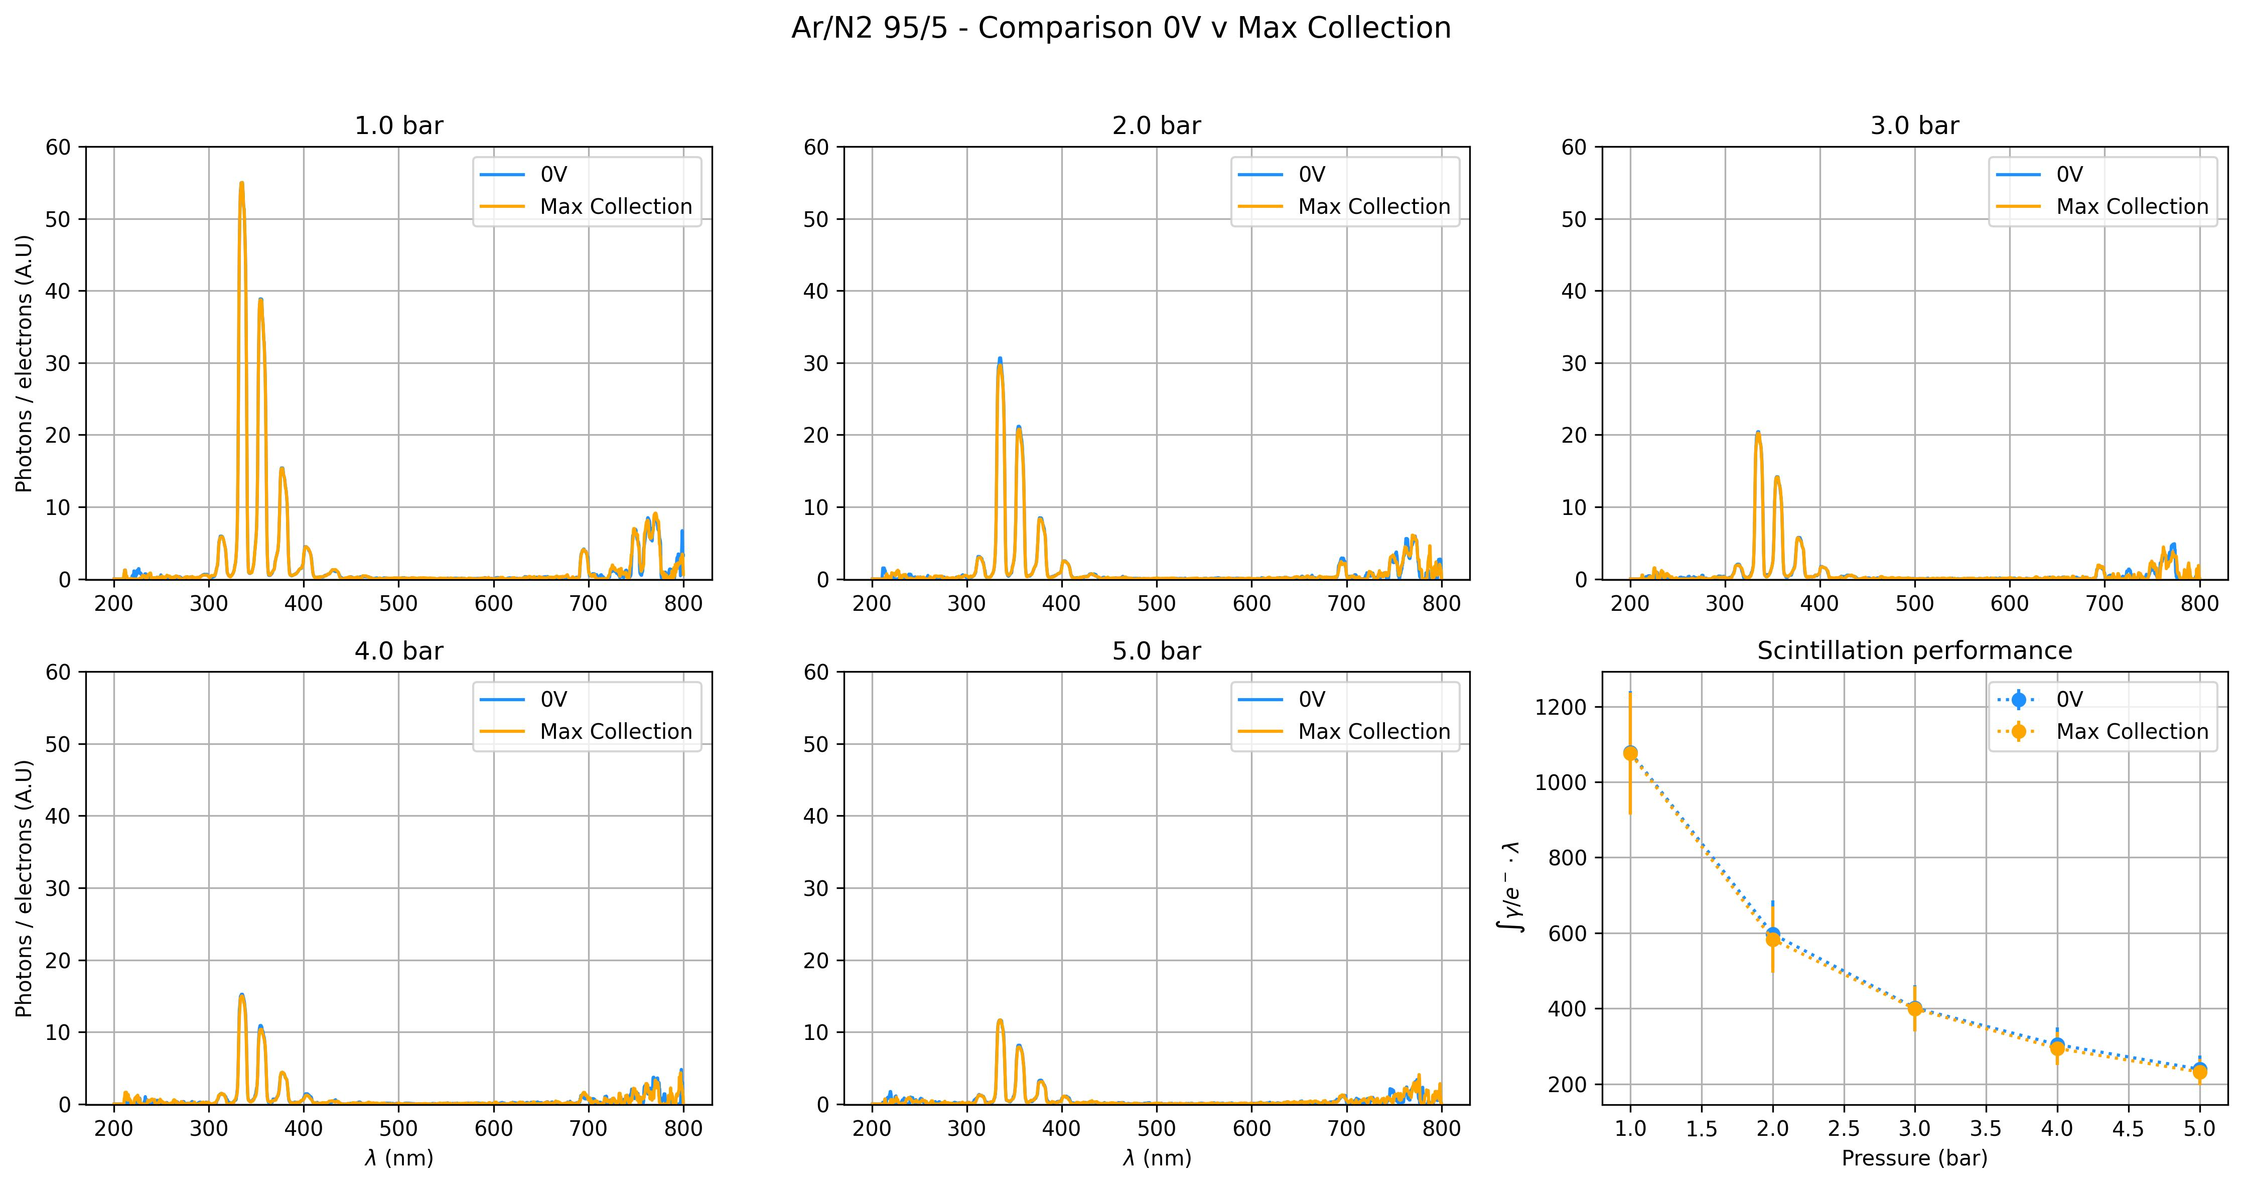
17

Slide 18
Results:
Effect of Nitric Oxide (NO) contamination in Ar/N2 scintillation spectra

Slide 19
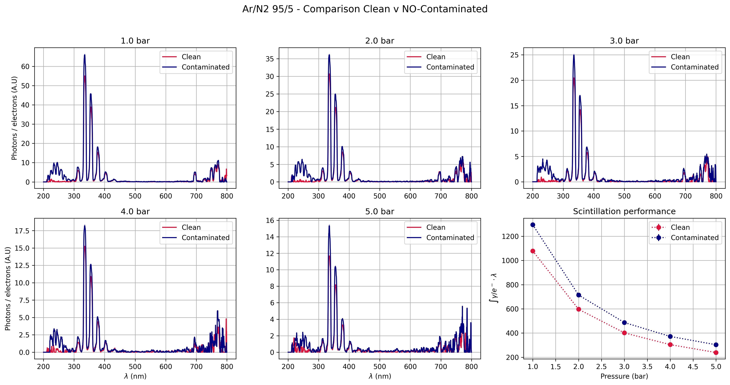
19
~1,5 ppm
< 0,1 ppm

Slide 20
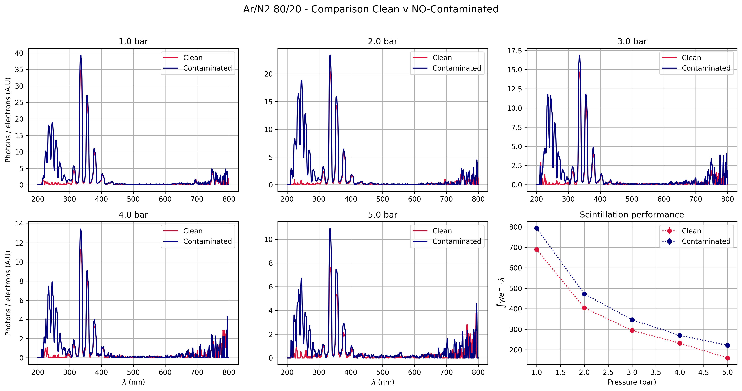
20
~6 ppm
< 0,6 ppm

Slide 21
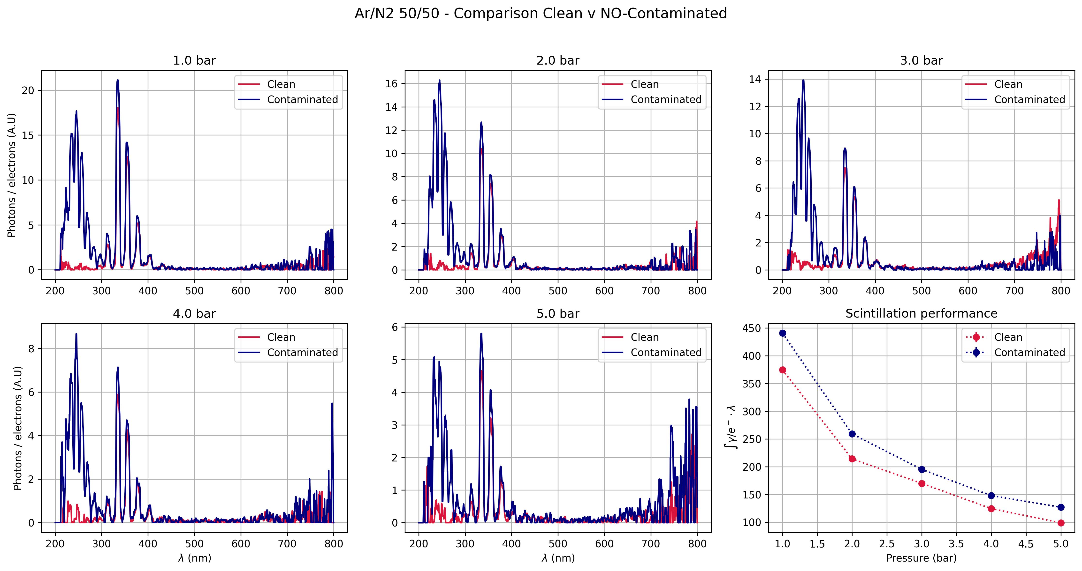
21
~10 ppm
< 1 ppm

Slide 22
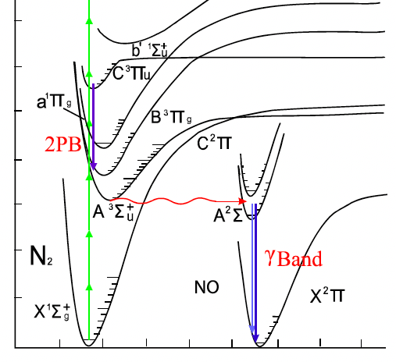
22
Theoretical Description
Secuence of transitions
Barco, G.
05 - 08 - 2025

Slide 23
23
NO contamination
Ar Scintillation
100 nm – 150 nm
NO Scintillation
200 nm – 300 nm
N2 Scintillation
300 nm – 450 nm
Barco, G.
05 - 08 - 2025

Slide 24
Results:
Scintillation yield of Ar/N2 mixtures

Slide 25
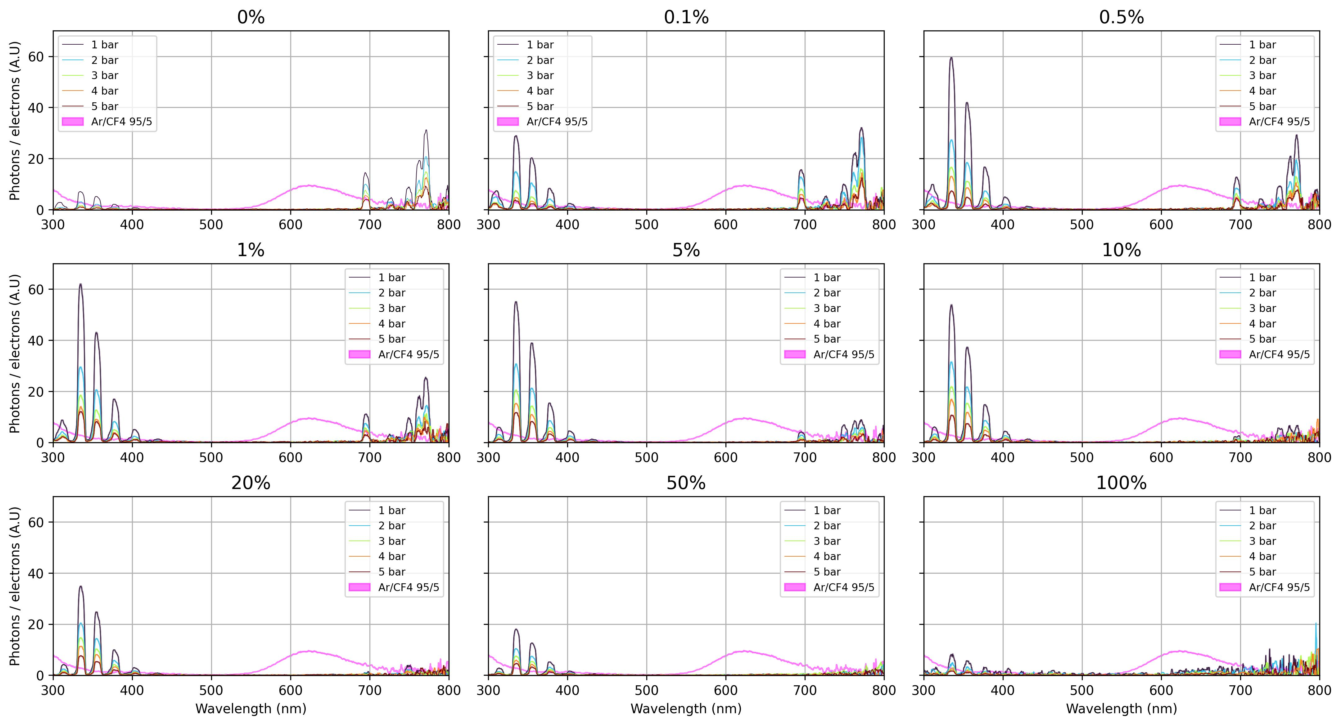
25
Barco, G.
05 - 08 - 2025

Slide 26
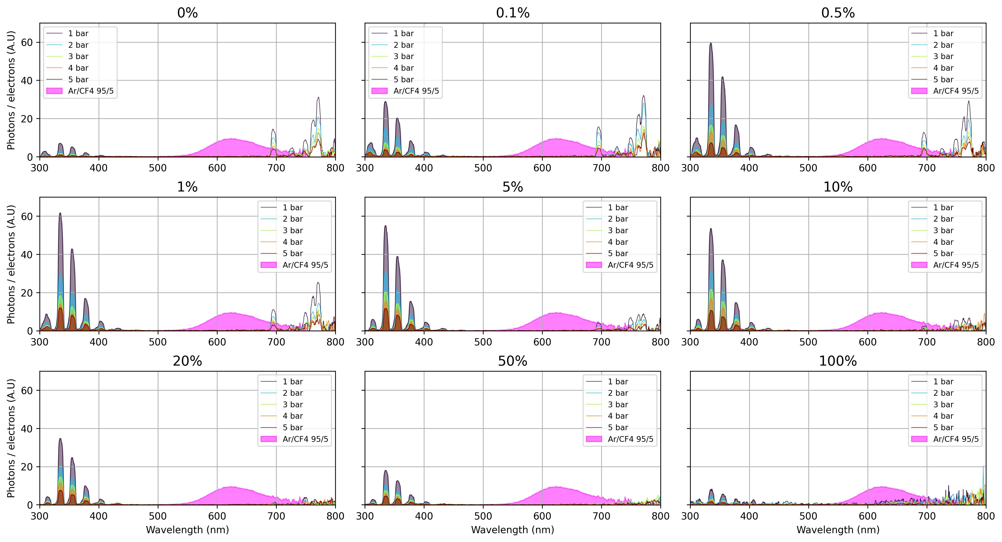
26
05 - 08 - 2025
Barco, G.

Slide 27
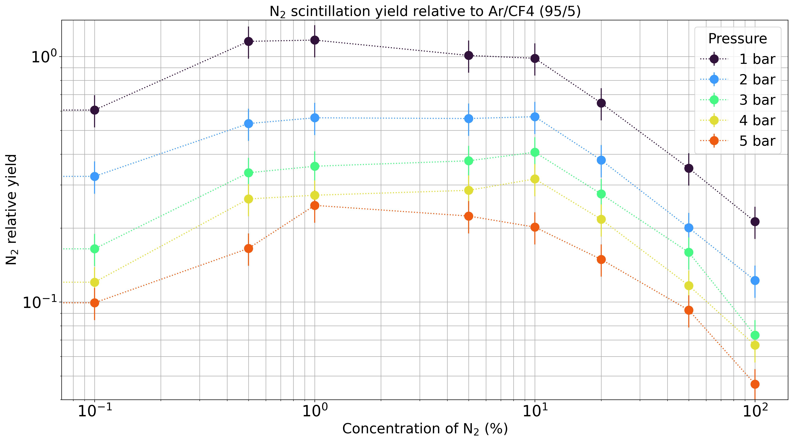
27
Barco, G.
05 - 08 - 2025

Slide 28
Conclusions
28
N2 seems to be a nice VUV- quencher, producing a wavelength to the range of 300-450nm.
Ar/N2 mixtures present a plateau between 0,1% and 10% where the best scintillation yield is measured. Meanwhile, this yield presents a dependence with pressure, being 1 bar its best performance.
Small quantities of N2 allow a scintillation yield much greater than pure N2 and pure Ar.
NO contamination at ppm scale produces UV-light that can affect the stability of the detector. But it could also be another useful source of scintillation. Further research is required.
Barco, G.
05 - 08 - 2025

Slide 29
Outlook
29
A study of secondary scintillation of Ar/N2 gas mixtures is scheduled to start in the next few weeks. Many mechanisms seen in Primary Scintillation are expected to be the same.
Other gas mixtures will be tested using this set-up, in order to stablish a station of gas characterization for gaseous detector use.
Scintillation of NO and its capacity to be used as a useful source is reserved for research to be done.
Barco, G.
05 - 08 - 2025

Slide 30
Thank you!
Genaro Barco
Supervisors:
Florian Brunbauer
Pablo Amedo
Diego Gonzalez Diaz
Notes:
Add DRD1 logo

Slide 31
Appendix

Slide 32
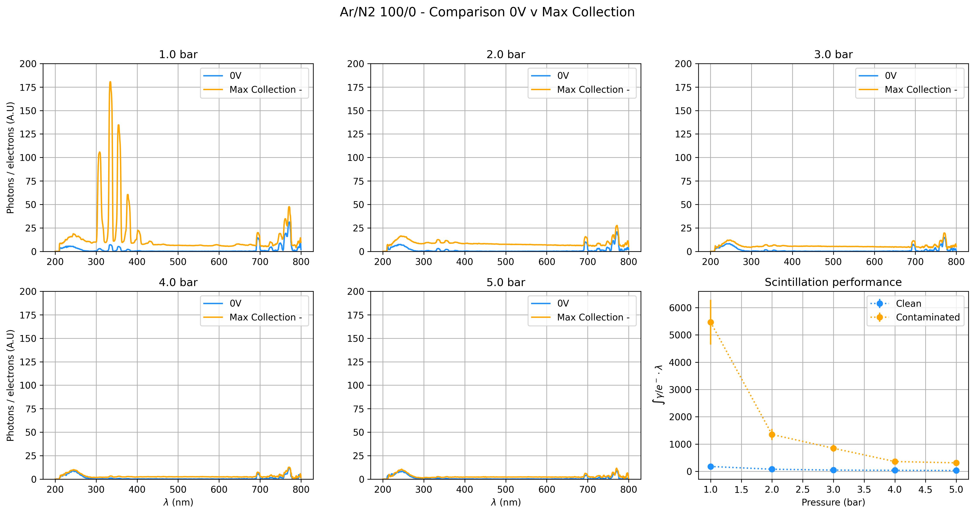
Notes:
Legend in bottom right plot

Slide 33
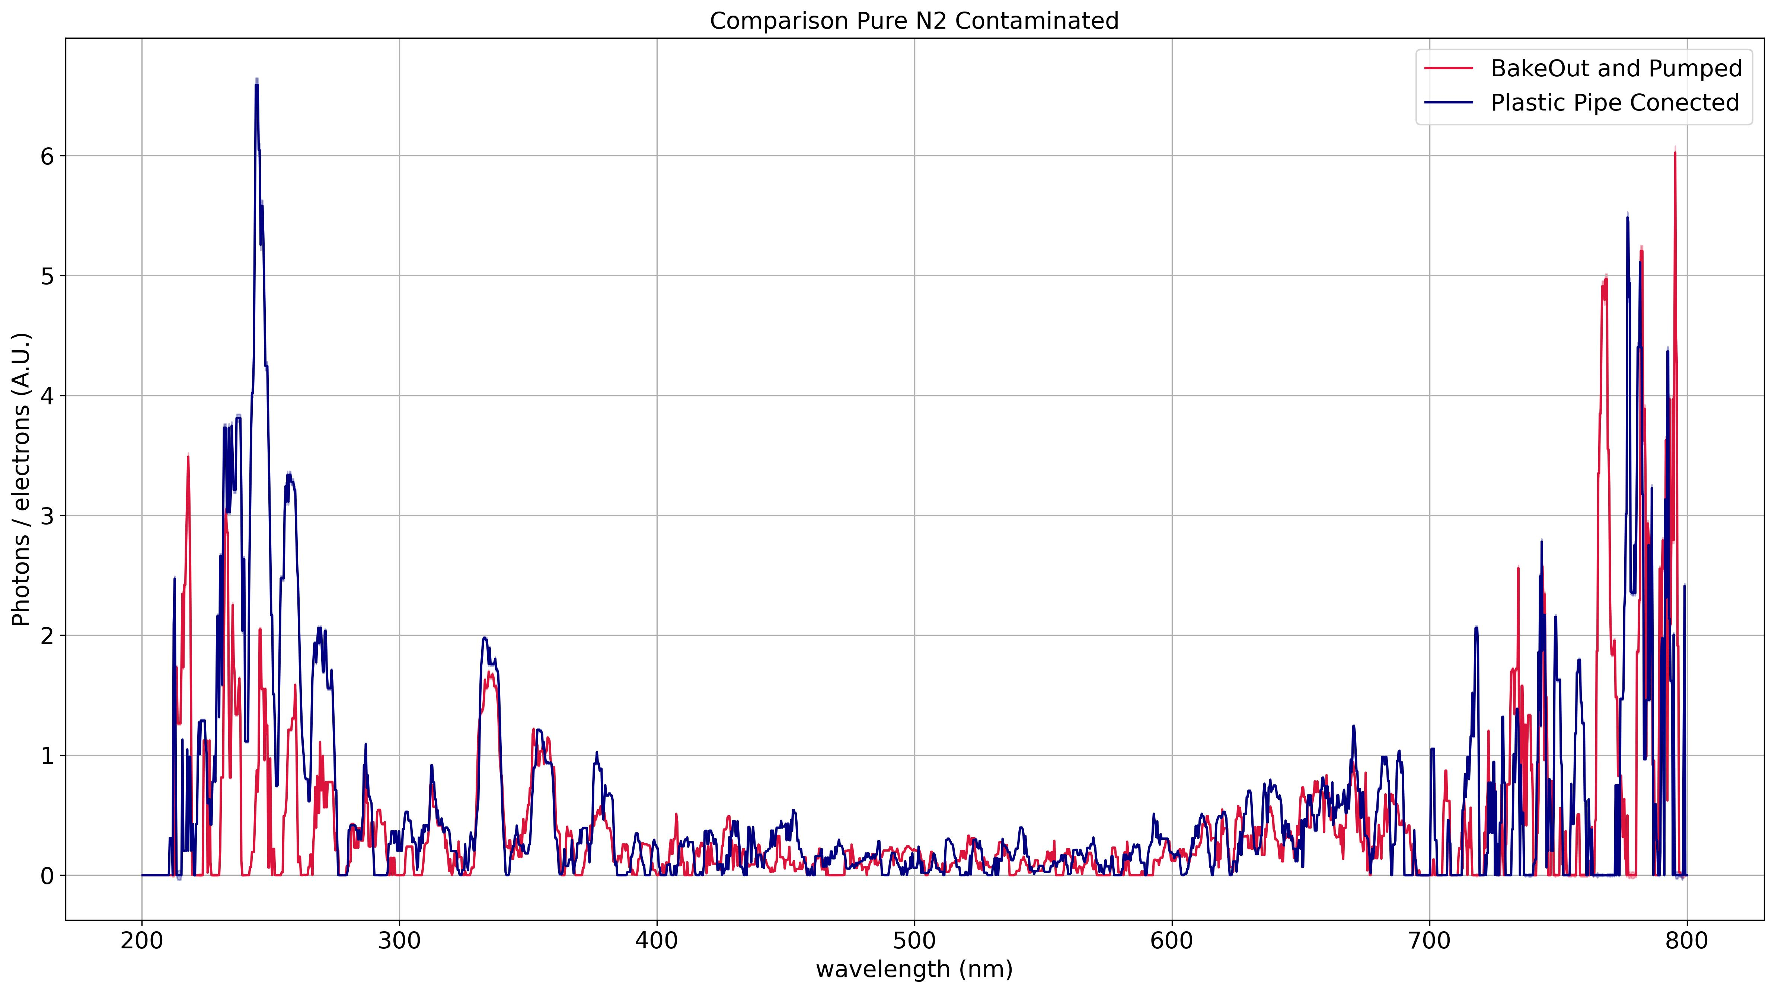

Slide 34
30 ppm
10 ppm

